Slide 1
Let’s Get Scary and Continuously Deploy Databases!
Dan Mallott

Slide 2
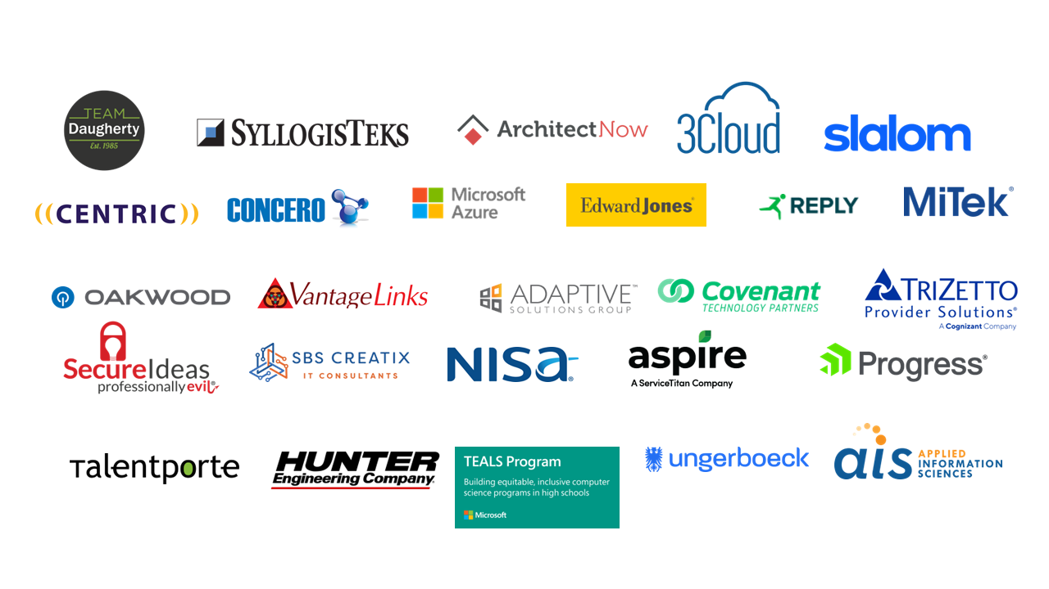
Please Thank the Sponsors!

Slide 3
On Deck
Introduction
CI/CD Refresher
The Data Problem
Modifying the Data Model
Automated Testing
State-Based Deploys
Migration-Based Deploys
Questions

Slide 4

DAN MALLOTT
1
SENIOR PRINCIPAL FOR WEST MONROE
2
DEVELOPING SOFTWARE SINCE 2011
3
STARTED AS A DBA – NOW A DEVELOPER
4
PRIMARY EXPERIENCE WITH MICROSOFT TECHNOLOGIES
5
ALSO, A USA (ICE) HOCKEY REFEREE
Twitter: @DanielMallott
GitHub: https://github.com/danielmallott
LinkedIn: https://www.linkedin.com/in/danielmallott
Notes:
Show the # of ideas in each phase so we focus more on

Slide 5
CI/CD Refresher
What does ”Continuous” really mean?

Slide 6

What does Continuous really mean?
CI/CD REFRESHER
CI
Continuous Integration
Developers merge their code into a “Main” branch as often as possible, with build and automated tests being run to validate the changes. In theory, Continuous Integration allows developers to find some bugs and integration issues sooner.
CD
Continuous Deployment
A logical extension of Continuous Delivery, which states that there should be an automated release process in addition to the automated build and test in Continuous Integration. Continuous Deployment means that every change is automatically pushed via the Continuous Delivery process directly to your end users assuming all tests have passed

Slide 7
The Data Problem
You Probably Don’t Want To Lose It

Slide 8
You Probably Don’t Want To Lose Your Data
THE DATA PROBLEM
Unlike application code, your data is stored as a resource, and, in theory, permanent
Changing the data model can result in data loss, and even removing “unused” tables can be a problem
This is mainly because your “code” (the data model) and your data are intertwined

Slide 9
How Many In the Audience Have a Database That Is the “Canonical” Data Store for That Data?

Slide 10
If Your Data Is the Canonical Version…
THE DATA PROBLEM
Changing the data model should be done with even more care
You will need to make sure you are aware of all the downstream consumers (reporting, ETL, etc)
This means talking to people outside your team
It also means that you may need more gates on your deployment

Slide 11
So How Do We Handle This?
A Field Guide To Modifying Your Existing Data Model

Slide 12
The Simple Cases
MODIFYING THE DATA MODEL
Adding…
Should be fine – just be sure to add it to MDM and Data Governance tools
…a Table or View?
…a Stored Procedure or Function?
Should be fine – just be sure to get your security correct
Check with other consumers of the table or view in question
…a Constraint?
No issues here – just be sure to check performance implications (and tell the DBA team)
…a Trigger?
There will be work to do here – check no code uses SELECT *, check index usage, make sure consuming code is updated, make sure you add it to MDM and Data Governance tools
…a Column?

Slide 13
The “You Do Have a Backup, Right” Cases
MODIFYING THE DATA MODEL

Slide 14
The “You Do Have a Backup, Right” Cases
MODIFYING THE DATA MODEL
Dropping...
Should be fine – if all consuming code has been updated and (for tables) the data is preserved
…a Table or View?
…a Stored Procedure or Function?
Should be fine – if all consuming code has been updated
Should be fine – if it is confirmed to be unneeded and/or application code is performing the business logic
…a Constraint?
The DBA team will throw a party
…a Trigger?
There will be work to do here – check no code uses SELECT *, check consuming code, update MDM, make sure the data is preserved somewhere, and (maybe) just rename the column
…a Column?

Slide 15
Now We’re Going To Get Complicated

Slide 16
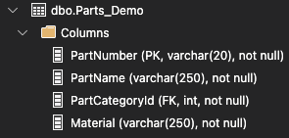
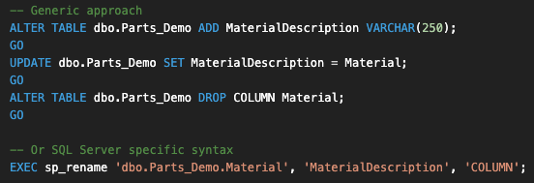

Let’s Change a Column Name
MODIFYING THE DATA MODEL
Say we have this table definition:
We might do this:
This is a breaking change (which might be bad), so we can add an alias to the table (a computed column):

Slide 17
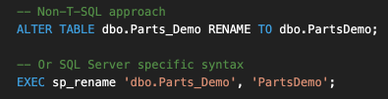

Let’s Change a Table Name!
MODIFYING THE DATA MODEL
Say we have a table that needs to be renamed:
We might do this:
This is a breaking change to any code (and the engine likely will not tell us about broken database objects), so we can either wait for people to yell or define a view:

Slide 18
What About Objects With Business Logic?

Slide 19
Unit Testing to the Rescue
MODIFYING THE DATA MODEL
Traditionally, application developers have used unit testing to help insulate code from unexpected breaking changes
We can also leverage unit testing to insulate our database code from unexpected breaking changes
You Should (Strongly) Consider Unit Testing Your Stored Procedures, Functions, Defaults, Computed Columns…

Slide 20
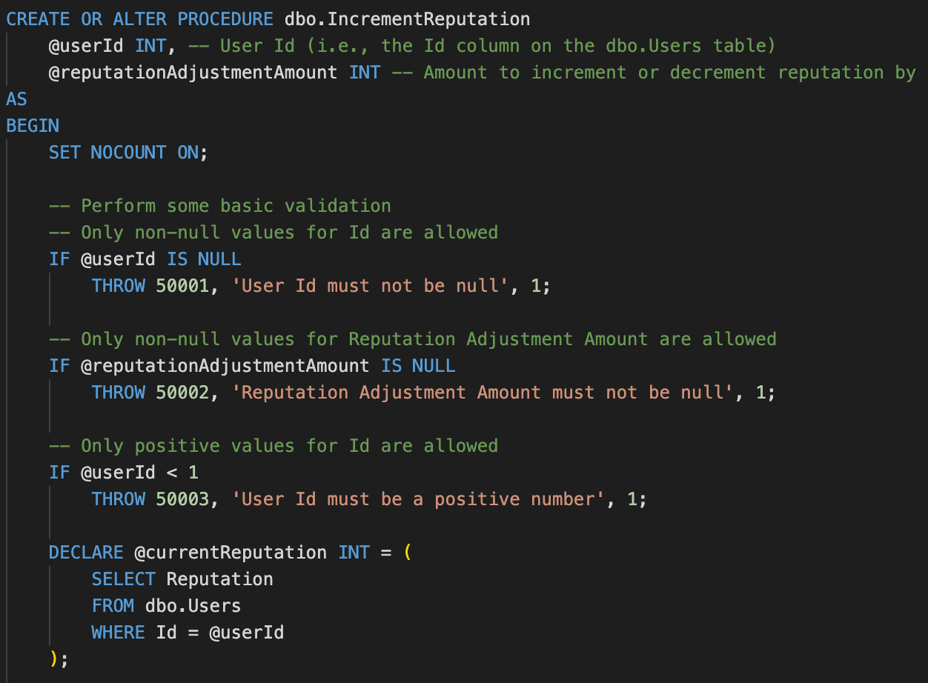
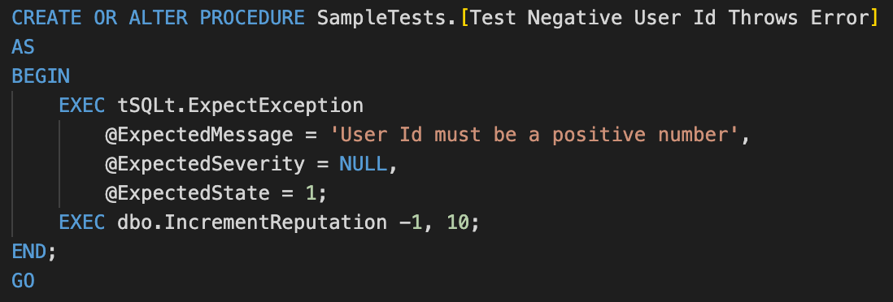
Stored Procedure And Unit Test Example
MODIFYING THE DATA MODEL

Slide 21
CI/CD Integration
Always Rolling Forward

Slide 22
First, Source Code Management
CI/CD INTEGRATION
State-based Tools
Migration-based Tools
State-based Tools generate a script to upgrade your database by comparing an existing database to the model stored in code
This can be automated or be run manually by developers
Examples include:
SQL Server Database Tools
Redgate SQL Source Control
Migration-based Tools assist in the creation of migration scripts that move the database from one version to the next
This is usually done from a baseline version
Examples include:
Flyway
Liquibase
Ruby on Rails Migrations
Other ORM Migration Tools

Slide 23
Second, Rolling Forward?
CI/CD INTEGRATION
Why always rolling forward?
It is much easier to ensure the state of the database when you are continuing to make changes rather than rolling back and then reapplying
This does not prevent you from needing to perform a restore at some point, but timeline of commits in source control will match the order of the database changes

Slide 24
Now, Demos

Slide 25
Questions?

